Slide 1
The Interactive Calorie and MacroNutrient Tracker
AUTHORS: doug Strueby, Nolan ruzicki and scott salmon
Team 14

Slide 2
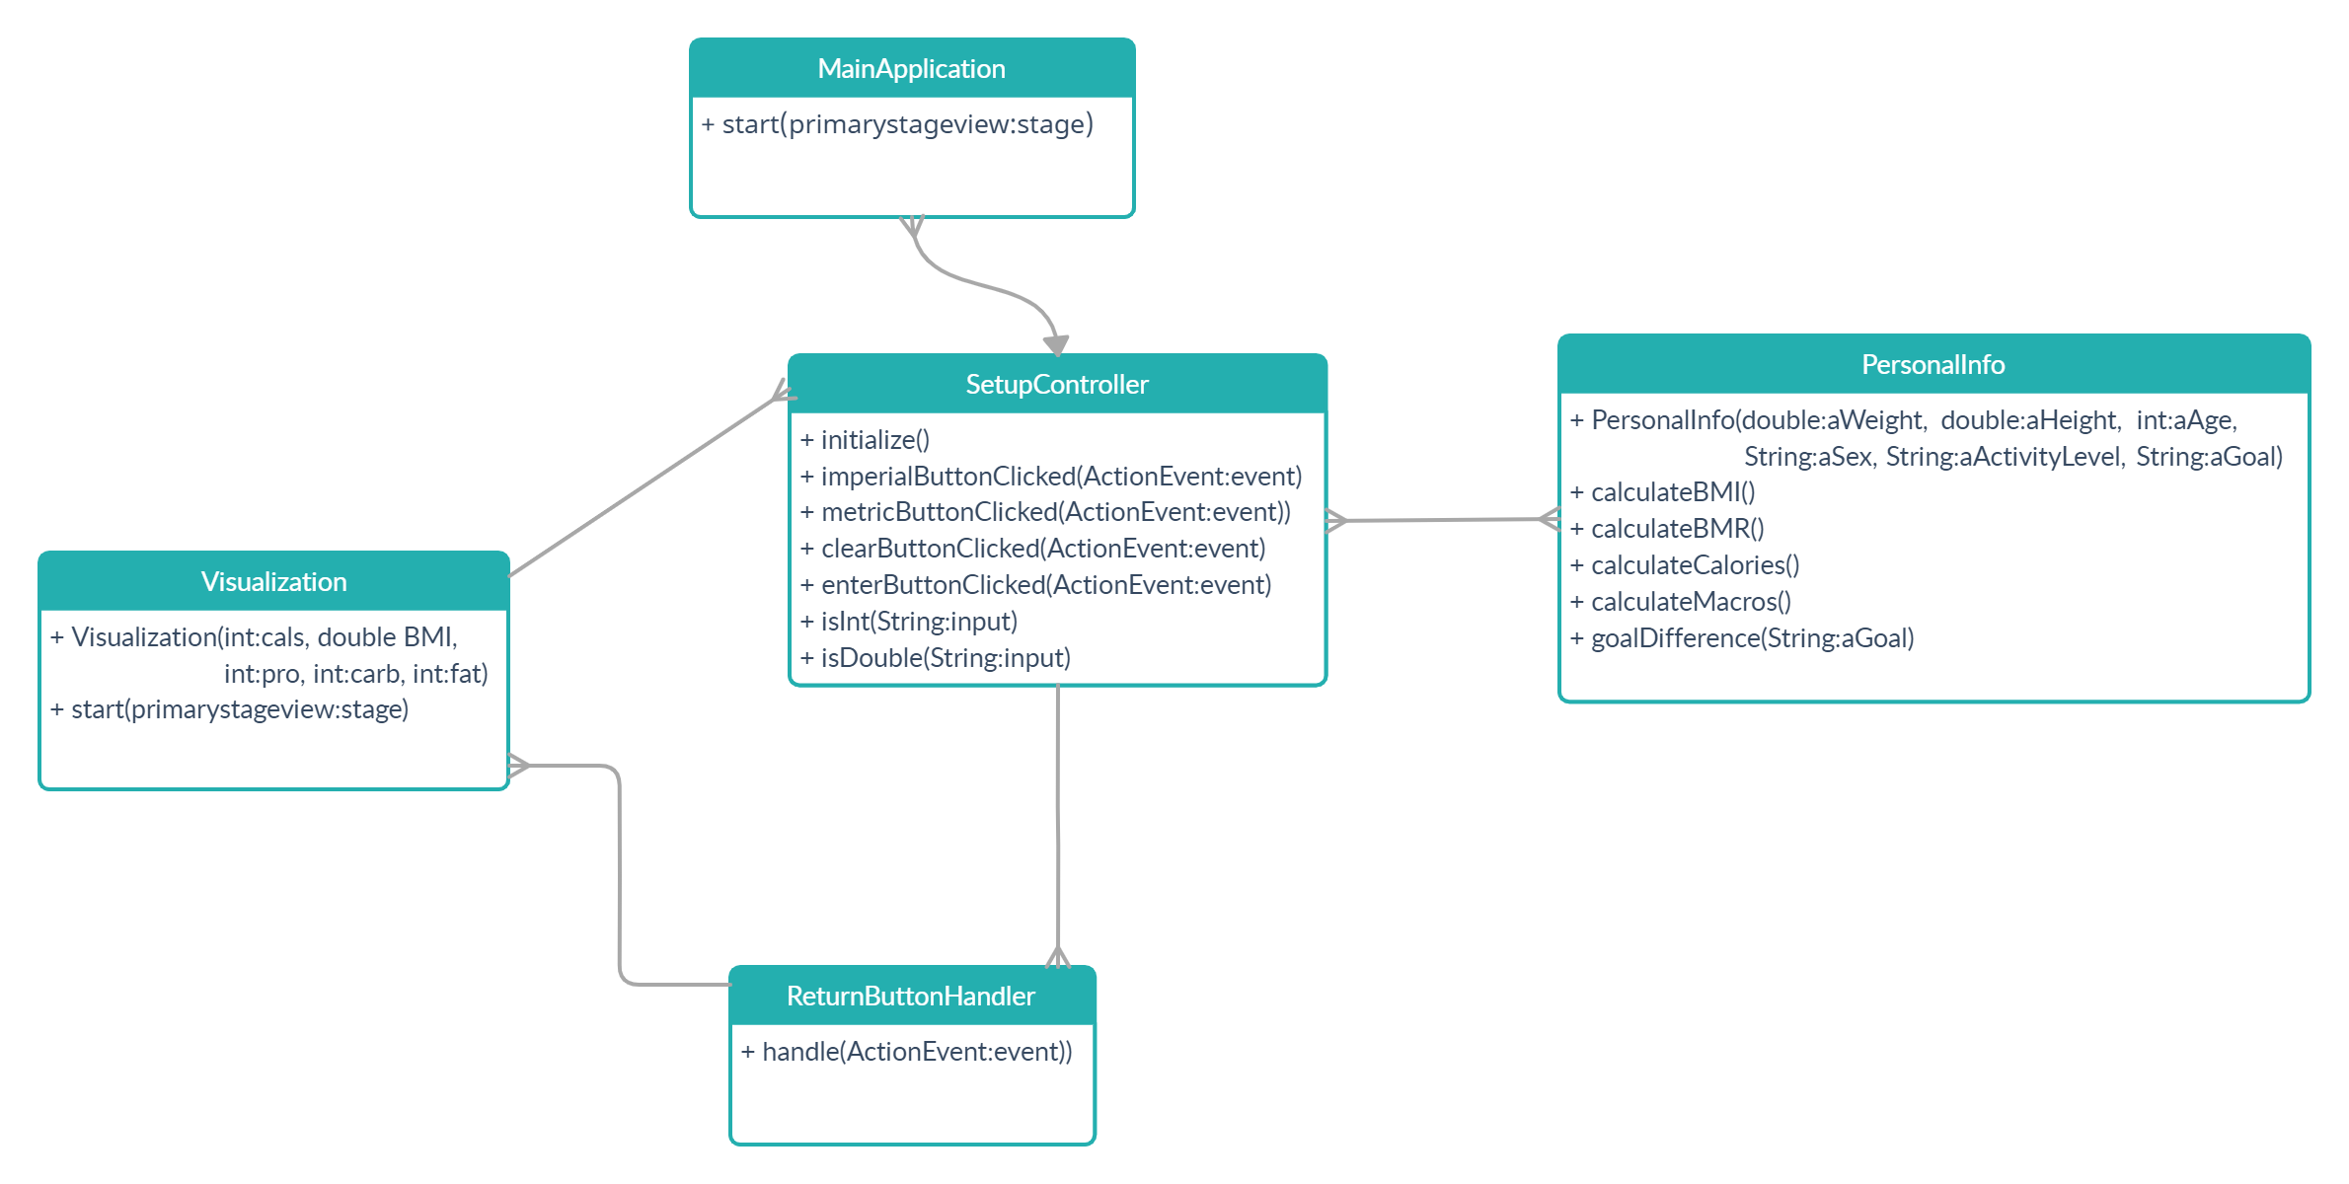
Class Diagram
“MainApplication” controls and initializes the entire program.
Then the setup controller is fired. The setup controller is constantly communicating with the Personal Information class to update and verify data.
If all data is correct, the setup controller fires the visualization class

Slide 3
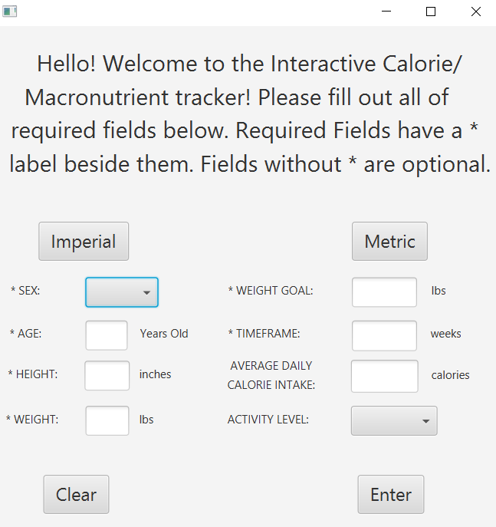
Setup Screen
- Metric/Imperial buttons so you can
swap units with ease
- Average Daily Calorie Intake and
activity level are both optional inputs
that slightly change the way some
values are calculated.

Slide 4
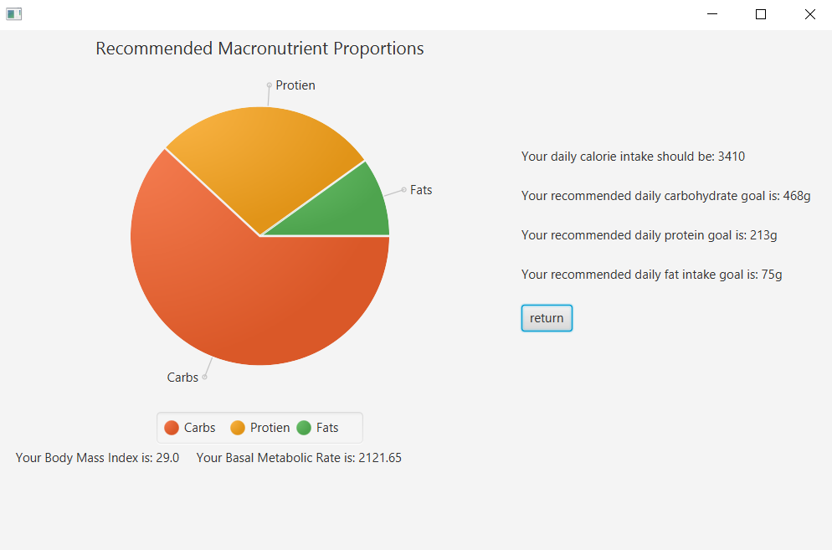
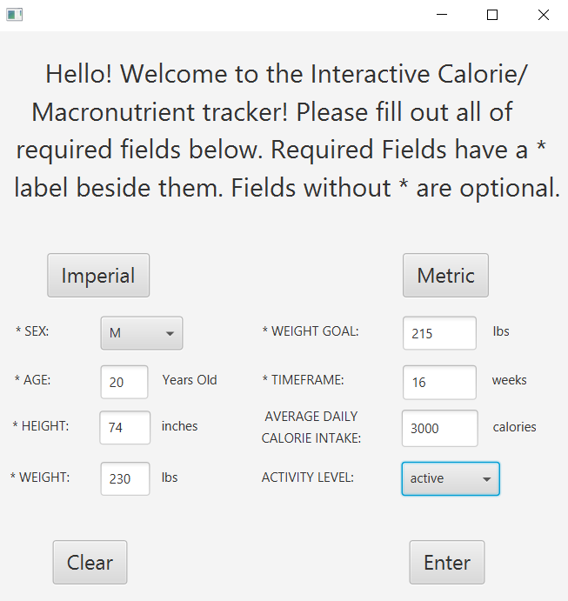
Example 1

Slide 5
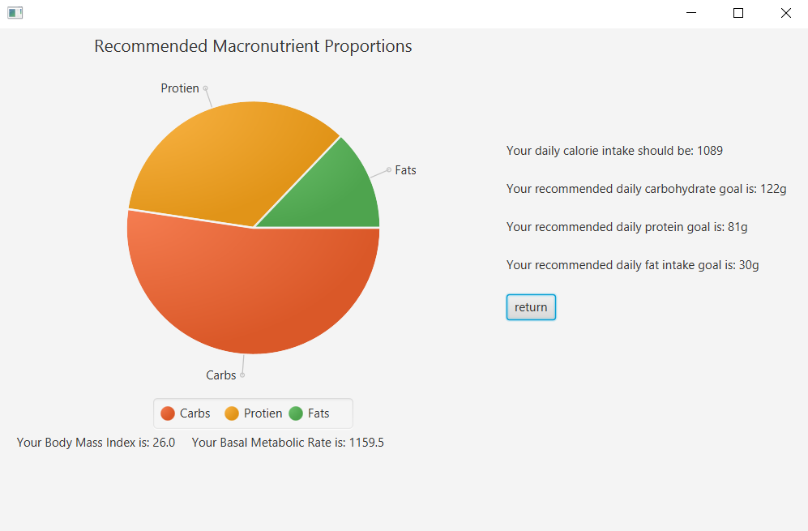
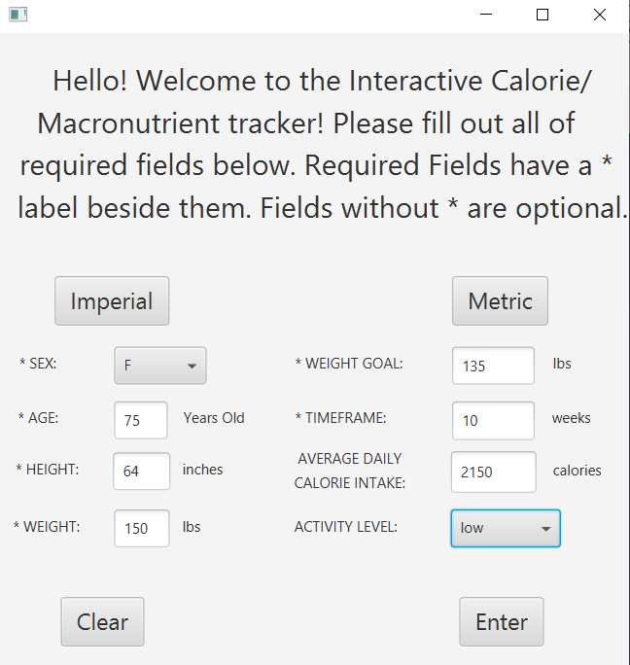
Example 2

Slide 6

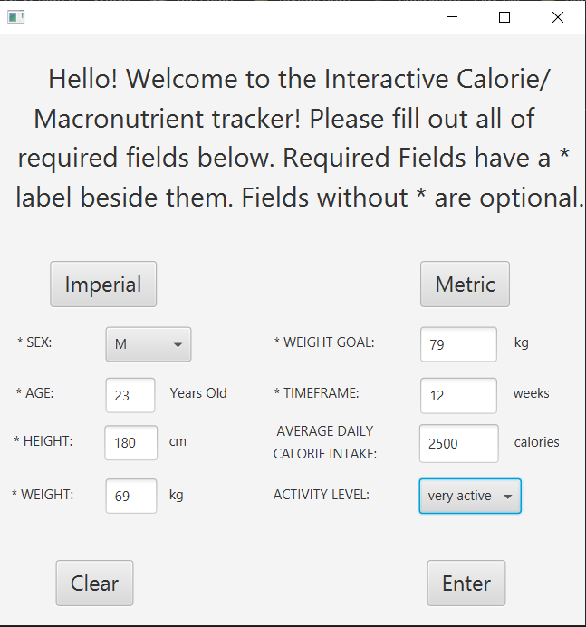
Example 3

